Slide 1
Git Tutorial for Beginners: A Quick Start Guide
IAmTimCorey

Slide 2
Goals of Source Control
Versioning
Improve Development Process
Historical View
Work with a Team

Slide 3
기본 사용법
// on local maching
cd c:/repos
git init get_demo // making repos
cd git_demo
git clone
… make some files
git status
git add [filename] // or $ git add .
git commit –m “message” // or $ git commit

Slide 4
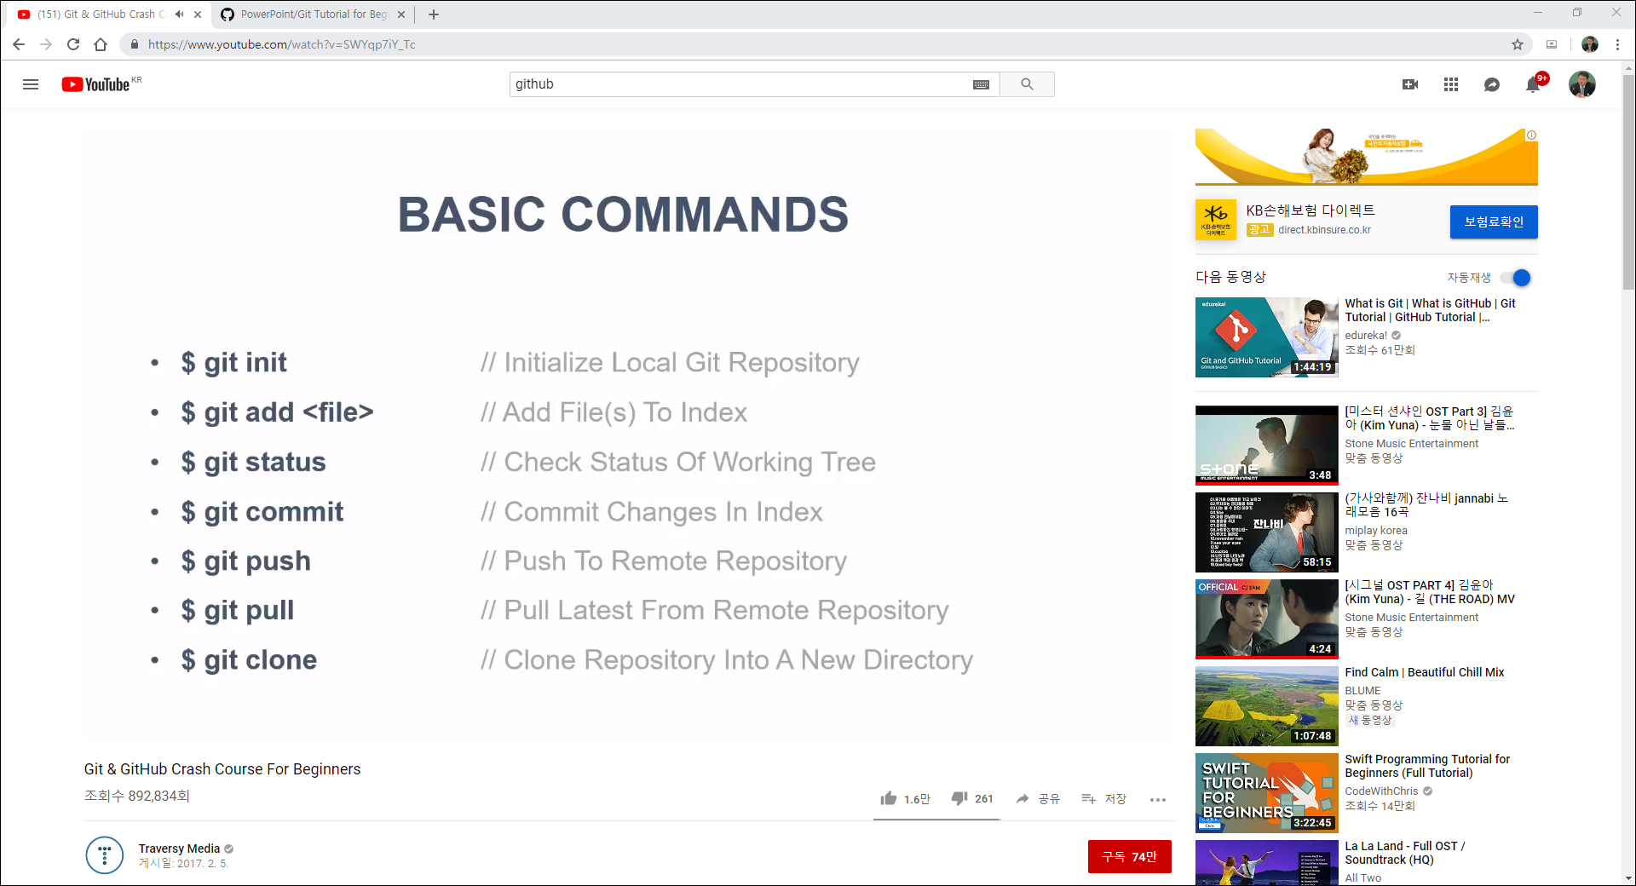

Slide 5
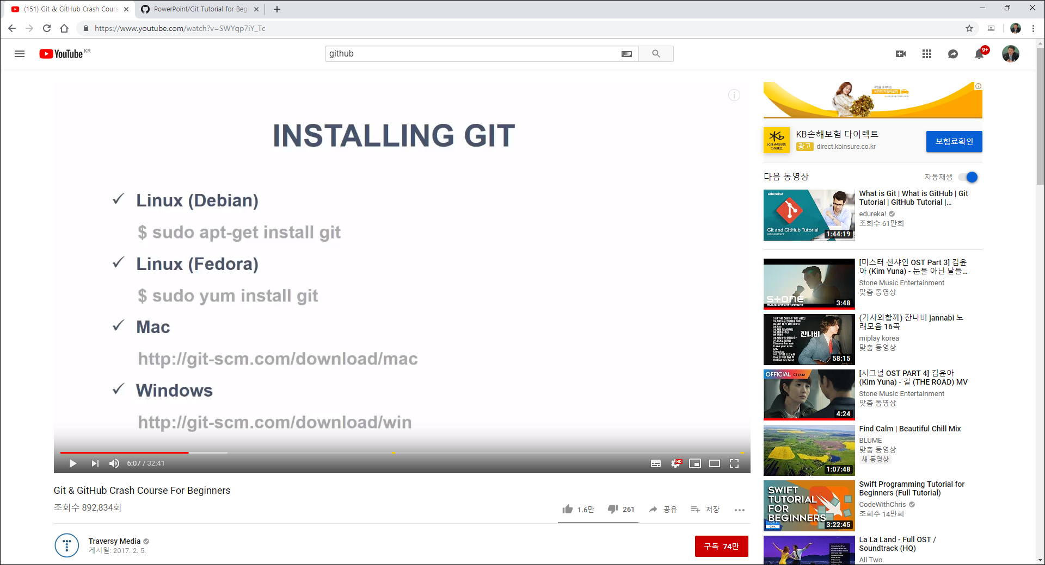

Slide 6
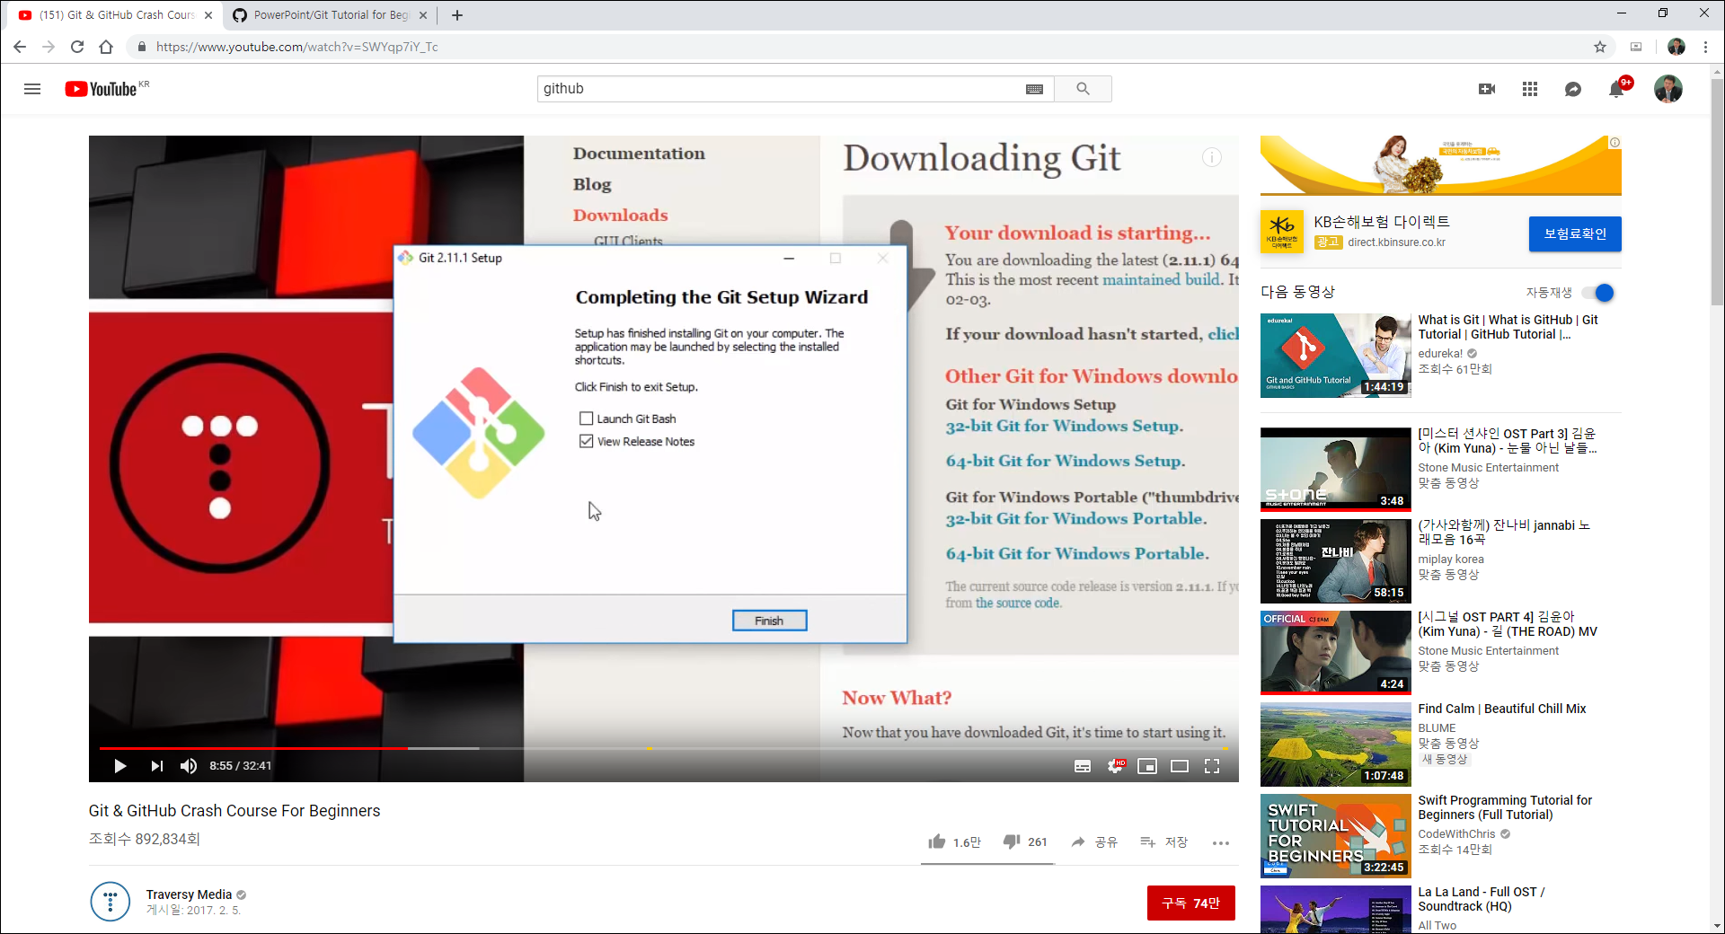

Slide 7
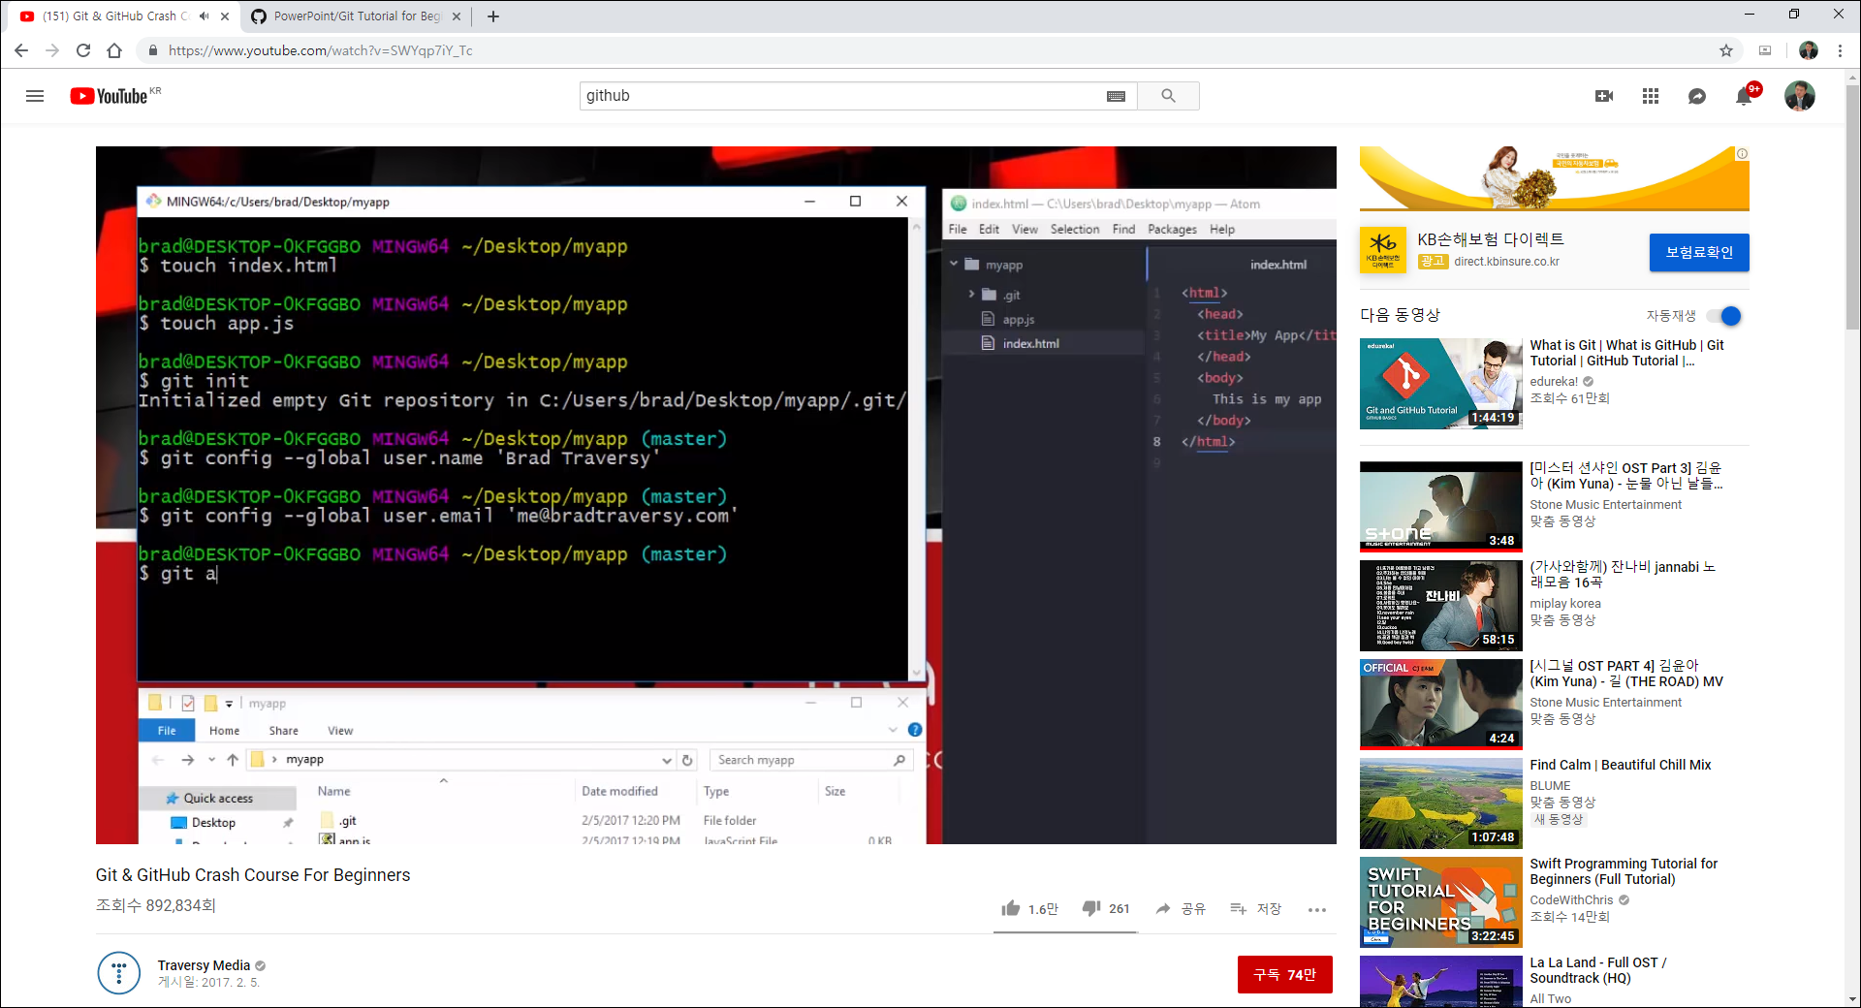

Slide 8
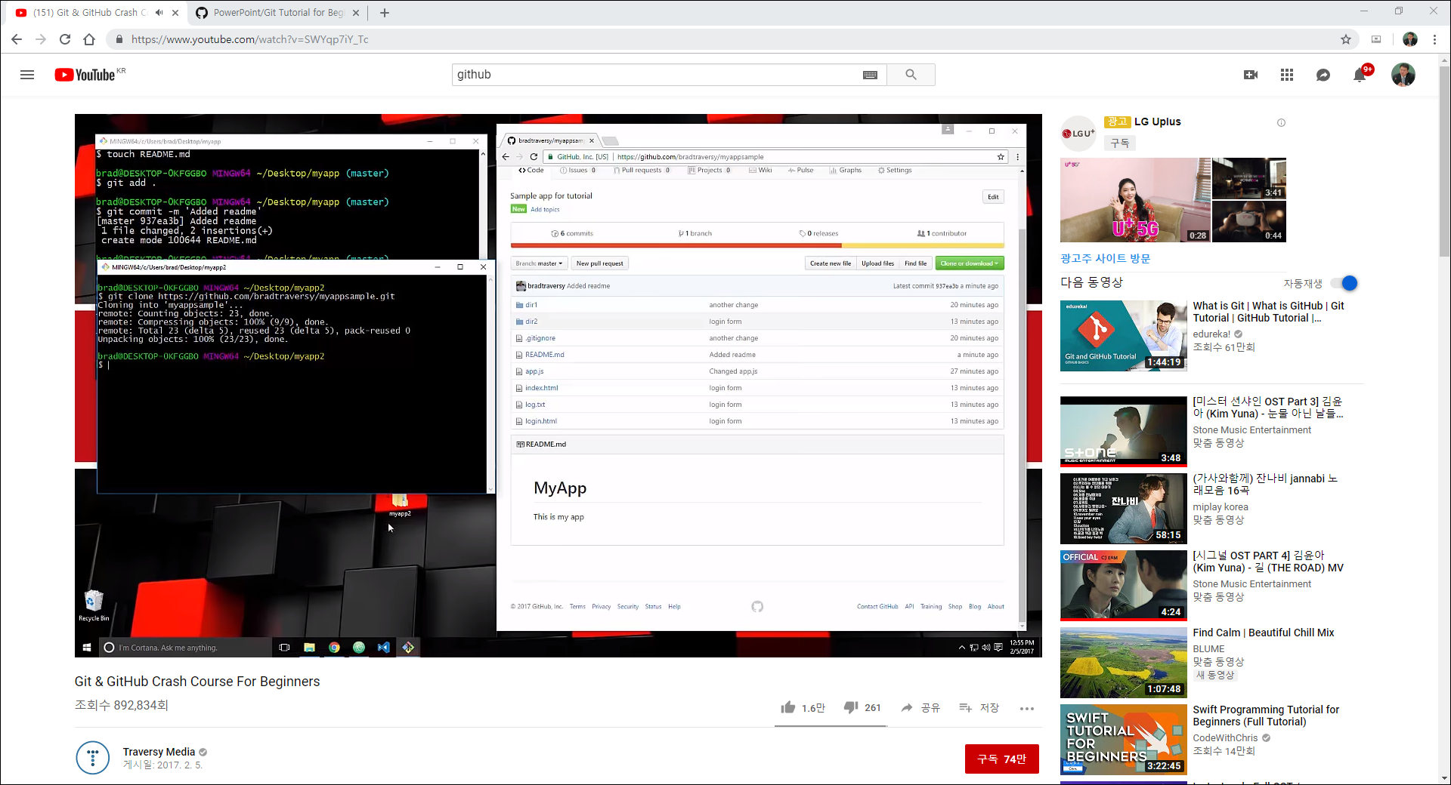
Clone : remote -> local

